Slide 1
Recommendation Systems
Ryan Wedoff & Zongsheng Sun
Stewart Group 3

Slide 2
Recommendation Systems: General Idea
Many companies and services recommend new products or ideas based on what you have previously rated, liked, or looked at
Ex:
Amazon
Netflix
Google

Slide 3
What did we do?
We created a movie recommendation system similar to Netflix
Users rate various movies and we predict/recommend which ones they will want to watch next.
We created our algorithms using Python, and numpy
Data From:
F. Maxwell Harper and Joseph A. Konstan. 2015. The MovieLens Datasets: History and Context. ACM Transactions on Interactive Intelligent Systems (TiiS) 5, 4, Article 19 (December 2015), 19 pages. DOI=http://dx.doi.org/10.1145/2827872

Slide 4
Method Used
Data Format
Movie
 |  |  | Rating |  |  | Rating
 | Rating
 |  | Rating |  |  | Rating
 | Rating |  |  |  |  |  | Rating
We started with a Sparse Matrix of Users X Movies and each entry was a rating
User

Slide 5
Method Used
SVD
Movie
 |  |  | Rating |  |  | Rating
 | Rating
 |  | Rating |  |  | Rating
 | Rating |  |  |  |  |  | Rating
We took the Singular Value Decomposition of this sparse matrix
User

Slide 6
Method Used
Other Additions
Movie
 |  |  | Rating |  |  | Rating
 | Rating
 |  | Rating |  |  | Rating
 | Rating |  |  |  |  |  | Rating
Avg = Average Rating per movie
Aer = Exceed Average Rate for each user (This is the “weighted” rating for each user. It is the rating for each movie – the average rating)
User

Slide 7
Method Used
Final Prediction
Movie
 |  |  | Rating |  |  | Rating
 | Rating
 |  | Rating |  |  | Rating
 | Rating |  |  |  |  |  | Rating
Ratings = Avg + aer[chosen_row] +svd[chosen_row]
Svd[chosen_row]
Left singular vectors * diagonal of the singular values * transpose of right singular values
User

Slide 8
What did we end up with?
A list containing the ratings for each of the movies
We sorted the list and kept the index (the index represented the movie_id)
We gave the top 10 recommended movie titles

Slide 9
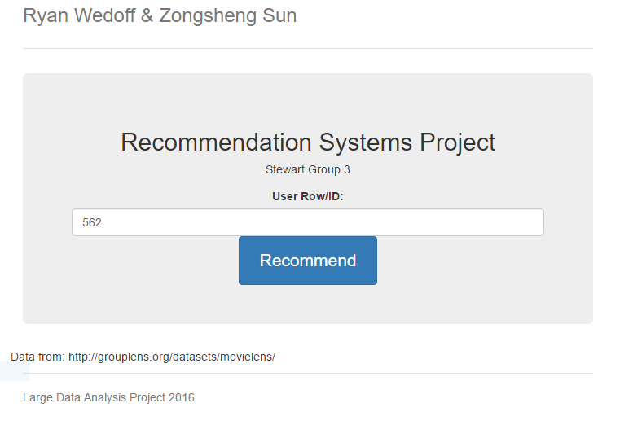
What did we Create
We created a demo Web App that takes a UserID and then gives Movie Recommendations.
The computation is done only once, and the results are saved so the user does not need to wait for the large data computations to be done.
Notes:
Do a demonstration here!

Slide 10
Observations
1,000,000 Rating set took a long time
This data set took a long time to process, but it made it through my computer after some time.
Based on visual observation, the issue of the 100,000 Rating set appears to be solved.
10,000,000 Rating was too big for my laptop.
Same solutions as before

Slide 11
Observations
100,000 Rating set was too small!
2 people rated Santa with Muscles (Movie_id: 1500) a 5 out of 5!
Because our model takes in account how well rated a movie is in general, the model believes that Santa with Muscles is the greatest movie ever and everyone should watch it!
Santa with Muscles got a 2.4/10 on IMDB.
Solution? Bigger Data Set, weighted movie averages?
20,000,000 Rating set was too big!
My laptop froze and then ran out of memory when trying to compute predictions for the 20,000,000 rating data set.
Solution? Get more memory, don’t save as many variables, GPU for faster processing, many more.

Slide 12
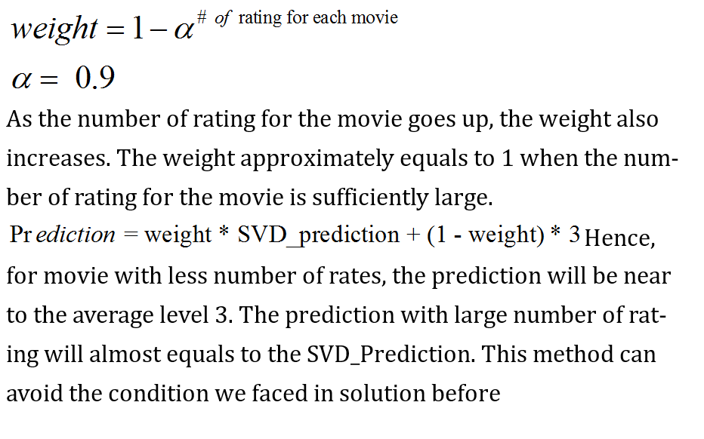
More on Santa with muscles

Slide 13
Our final Calculations
rel_array1 = u[chosen_row].dot(sigma).dot(vt) + average_rating + average_exceed_rating.item(chosen_row) rel_array1 = np.multiply(rel_array1, weight_for_movie) + (1 - weight_for_movie) * 3 Final_Preds = rel_array1 - (sparse_matrix.getrow(chosen_row) != 0).multiply(rel_array1)

Slide 14
Testing
The Movie Lens Data come broken up into a test and base data set
We calculated recommendations for every user using the 100,000 rating set
Calculated mean squared error to determine how well our predictions were.

Slide 15
Testing
This process was done on various data sets u1, u2, u3, u4, ua, ub. Each set was broken up on various conditions created by Grouplens.org
We ran tests and calculated the Mean Squared Error for each dataset, under 3 tests
Test 1: Just the Main SVD done
Test 2: Main SVD + Average Rating per Movie
Test 3: Main SVD + Average Rating per Movie + Exceed Average Rating
Our Method: Main SVD + Weighted Avg. per Movie + Exceed Avg. Rating

Slide 16
Testing Results
SVD on | u1 | u2 | u3 | u4 | ua | ub | Average
Original matrix | 2.87659289 | 2.76577005 | 2.69006711 | 2.71137178 | 2.8481686 | 2.86360473 | 2.7925959
Only subtract Avg. Movie Rating | 0.99705938 | 0.98746208 | 0.98036265 | 0.97728907 | 1.00559303 | 1.01613083 | 0.9939828
Weighted rating per user | 0.95048582 | 0.93893182 | 0.9387754 | 0.93524512 | 0.95632111 | 0.97042699 | 0.9483644
Weighted Avg. Movie Rating | 0.94751591 | 0.93480794 | 0.92772242 | 0.92600982 | 0.9530763 | 0.96527947 | 0.942402
Our method, test 3 had the lowest Mean Squared Error Average. Our predictions were off by roughly 1 star for each movie.
These results are not the most promising but do provide a decent recommendation for movies.

Slide 17
Questions?
Thanks for listening!

